Slide 1
Multimodal Biometric Systems
Under the Guidance of :
Dr. Joyeeta Singha
Prepared By :
19ucc023 – Mohit Akhouri
19uec023 – Hitesh Goyal
19uec113 – Agraj Garg
19ucc043 – Aditya Pandey

Slide 2
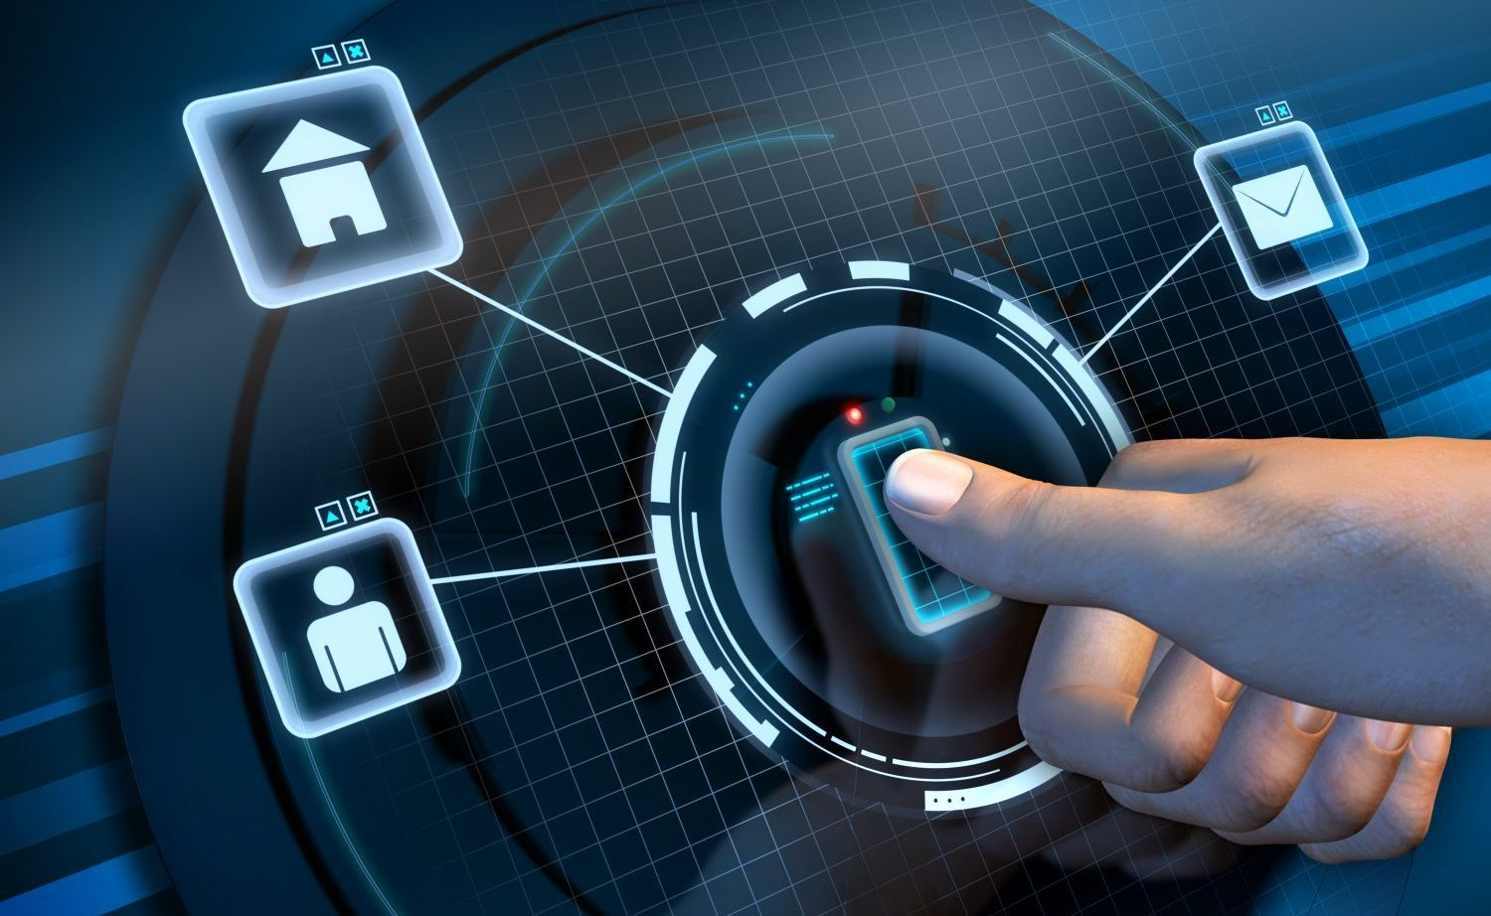
What are Biometric Systems ?
Biometric Systems use personal characteristics of a person to authenticate or identify a person.
Some of the Biometric characteristics that can be used are as follows :
Face
Fingerprint
Hand Geometry
Palm Print
Iris
Voice
Signature
Keystroke dynamics

Slide 3
Aim and Objective
The Aim of the project is to design a multimodal biometric system which could be used for verification and recognition purposes.
Our objective is to design such a multimodal biometric system which provides better results in terms of reliability, security and accuracy compared to the unimodal biometric systems.
Unimodal Biometric systems perform person recognition based on a single source of biometric information.
Unimodal systems are often affected by some problems which are discussed in the upcoming slides.

Slide 4
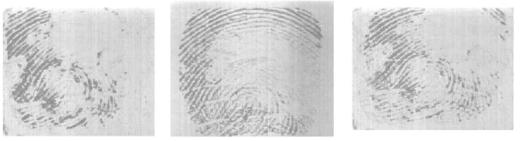
Why Multimodal Biometrics ?
Noisy Sensor Data – Noise can be present in the biometric data which is acquired due to defective or improperly maintained sensors.
Non-Universality – A Biometric trait is said to be universal if every individual in the target population is able to present biometric trait for recognition. NIST reported 2% people cannot enroll using finger print.
Lack of Individuality – Features extracted from biometric characteristics of different individuals can be quite similar. A small proportion of population can have nearly identical facial appearance due to genetic factors.

Slide 5
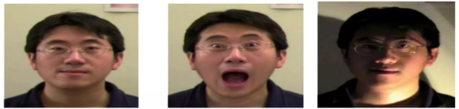
Why Multimodal Biometrics contd….
Lack of invariant representation – The biometric data acquired from user during verification may not be identical to data used for generating user’s template during enrollment.
Spoofing – Unimodal Biometrics is vulnerable to spoofing where the biometric data can be imitated or forged.

Slide 6
Applications
There are many applications of biometric systems which are :
Access Control – Biometric systems can be used for access control in physical spaces such as offices, govt. buildings, airports and residential complexes.
Time and Attendance – Biometric systems can be used for time and attendance management in workplaces, schools and other organizations.
Financial Services – Biometric systems are used in the financial sector for secure authentication and fraud prevention.
Forensics – Biometric data such as fingerprint, DNA and facial features can be used in forensic investigations.
Border Security – Biometric systems are deployed at border checkpoints to enhance security and facilitate immigration process.

Slide 7
Literature Survey
“Multimodal Biometric System Based on Fingerprint, Iris and Face Recognition” By Smith et al.
Proposes a multimodal biometric system that combines fingerprint, iris and face recognition modalities.
The paper focused on developing efficient feature extraction techniques for each modality and explore fusion strategies to integrate information efficiently.
The authors conducted experiments using a large dataset and achieved superior recognition accuracy compared to unimodal biometric systems.
The multimodal biometric system designed has enhanced security and robustness against spoofing attacks.

Slide 8
Literature Survey contd….
“A Novel Approach for Multimodal Biometric Fusion using Deep Learning” By Lee et al.
This paper presents a novel approach for multimodal biometric fusion using deep learning techniques.
It presents a deep neural network architecture which combines features extracted from fingerprint, iris and face modalities.
Deep Learning improved the accuracy and reliability of multimodal biometric systems.
These systems can be used where accurate identification is crucial.

Slide 9
Literature Survey contd….
“Secure Multimodal Biometric System based on Fingerprint and Palmprint Fusion” By Chen et al.
This research paper focused on development of secure multimodal biometric system using fingerprint and palmprint fusion.
The proposed system combines features extracted from fingerprint and palmprint modalities using a fusion algorithm based on score-level and feature-level fusion techniques.
The proposed system demonstrates enhanced accuracy and resilience against spoofing attacks compared to unimodal systems.
These systems can be used in access control and identity verification.

Slide 10
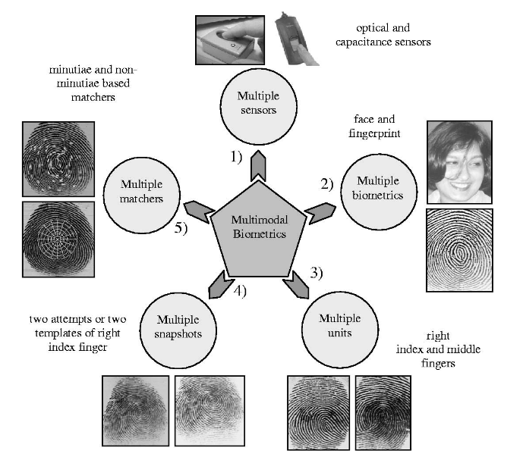
Scenarios in Multimodal Biometric Systems

Slide 11
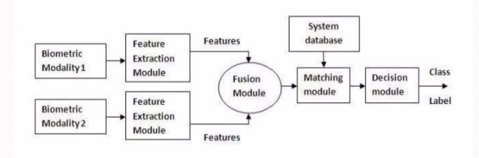
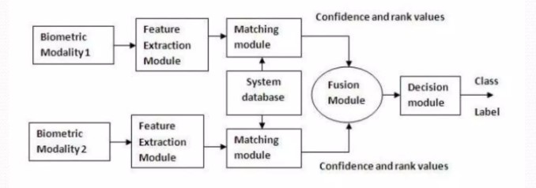
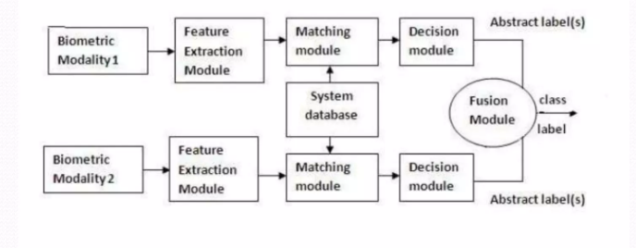
Fusion in Multimodal Biometric Systems
Feature Level Fusion – Combining feature vectors. When features of different modalities are compatible with each other, then more accuracy.
Matching Score Level Fusion – Individual matching score of different feature vectors is found and fused to make classification.
Decision Level Fusion – Each biometric modality makes it own recognition decision based on its feature vector.

Slide 12
Proposed System
We can make a multimodal biometric system using these two modalities :
Facial Features ( Visual Modality )
Audio ( Auditory Modality )
The system will capture facial and voice biometric data from individuals. This can be done using a camera or webcam to capture facial images and a microphone to record voice samples.
The captured data will be pre-processed to enhance quality.
Feature extraction will be done from the pre-processed data.
The extracted features will be combined using a fusion algorithm.
Finally, the fused features will be compared with the enrolled templates in database and based on similarity scores, a decision will be made.

Slide 13
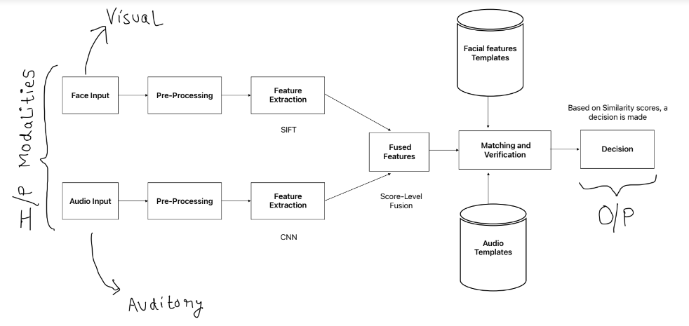
Workflow of the system designed

Slide 14
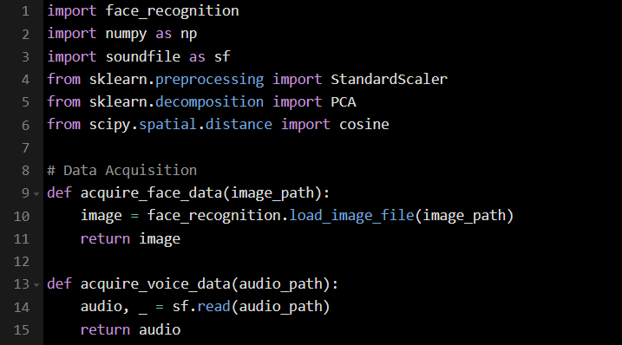
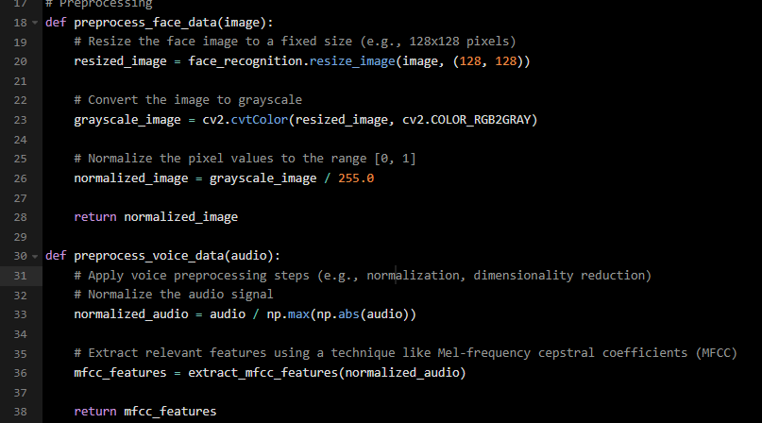
Code Snippets

Slide 15
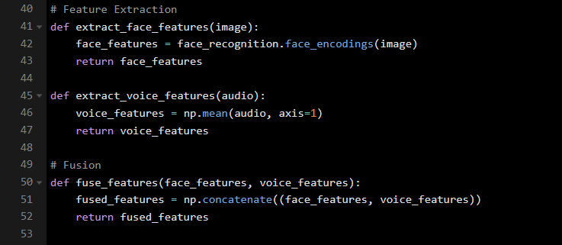
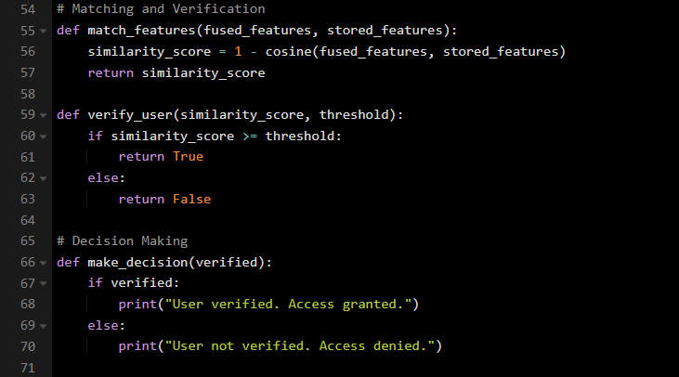
Code Snippets contd….

Slide 16
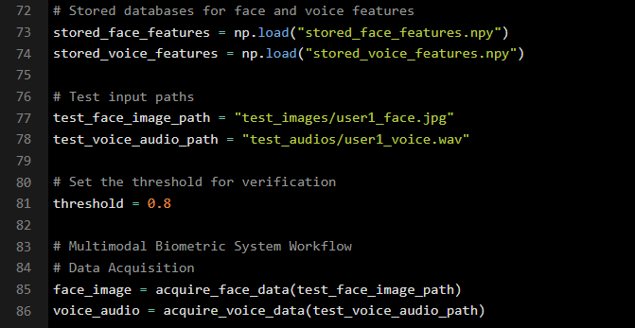
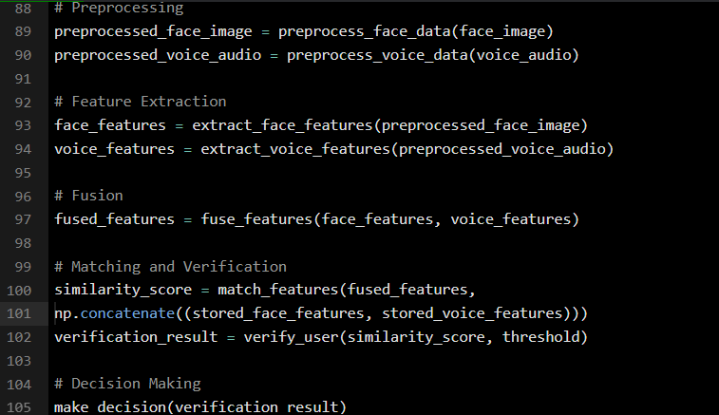
Code Snippets contd….

Slide 17
Results and Findings
The Multimodal biometric system designed offered several advantages compared to the unimodal counterparts which are :
Improved Accuracy – By utilizing both facial and voice modalities, system can benefit from the complementary information provided by each modality thereby reducing false acceptance and false rejection rates.
Enhanced Robustness – Face Recognition may be susceptible to illumination variation while voice recognition may be affected by background noise. By integrating both modalities, more reliable authentication is there.
Improved User Experience – Users can authenticate themselves using face and voice simultaneously.
Increased Resistance to Spoof Attacks – Attempting to spoof both voice and face may be difficult for attackers.

Slide 18
Conclusion and Future Work
In conclusion, multimodal biometric systems enhances accuracy and reliability compared to their unimodal counterparts.
However, there are still some challenges which need to be addressed which are :
Performance Improvement – We can develop more advanced fusion algorithms that reduce false acceptance and false rejection rates and are more accurate.
Usability and User Experience – Efforts can be made to address user concerns and improve the usability of multimodal biometric systems.
Scalability and Efficiency – We can conduct research to develop scalable and efficient multimodal biometric systems to handle large user populations.
Ethical and Privacy Considerations – Future work in multimodal biometrics should emphasize on ethical considerations and privacy protection.

Slide 19
References
S. Ribaric, Kristina Kis, “A biometric verification system based on the fusion of palmprint and facial features”, October 2005
A. Khattab, “Multi-modal Biometric System”, October 23, 2016
Priyanka S. Patil, A. Abhyankar, “Multimodal Biometric Identification System Based on Iris & Fingerprint”, 2013
Rajendra Prasad Nayak, “Seminar on Multimodal Biometric Systems”, NIT Rourkela
Blaise Craig, “Multimodal Biometric Security”, 2017
https://www.innovatrics.com/glossary/biometric-system/

Slide 20
THANK YOU

